Slide 1

Team Name : TEAM KANYARASHI
Team Leader Name : KALAKONDA AKSHAY
Problem Statement :Problem Statement 15 – The Cash-Only Shopkeeper

Slide 2
Team Members
Team Leader: KALAKONDA AKSHAY Name: College:Amrita Vishwa Vidyapeetham | Team Member-1: Polla Srujan Kumar Name: College: Amrita Vishwa Vidyapeetham

Slide 3
Opportunity : Current Problem :
Rural shopkeepers want digital tools but find existing solutions complex and difficult to use.
Target Users :
Kirana stores, street vendors, tea stalls, and small businesses in rural & Tier 2/3/4 areas.
Pain Points :
Limited digital payment adoption
Poor income & expense tracking
Manual inventory management
Limited access to loans
Low financial literacy
Why Existing Solutions Fail :
Complex interfaces
Weak offline support
No AI-based financial guidance
No credit-building for small businesses
Market Opportunity :
63M+ MSMEs in India need simple AI-powered financial solutions.
Expected Impact :
Digital adoption • Better financial management • Easy credit access • Business growth
Government Relevance :
Supports Digital India, Startup India, Financial Inclusion, and Viksit Bharat 2047.

Slide 4
List of features offered by the solution: 1. Voice-Based Ledger – Record transactions using voice in local language.
2. Smart UPI QR Payments – Accept instant digital payments with QR codes.
3. AI Vyapar Score – AI-generated business credit score for loan eligibility.
4. Expense & Profit Tracker – Automatically track income, expenses, and profits. 5. Inventory Management – Smart stock tracking with low-stock alerts.
6. Offline Mode – Works without internet and syncs automatically.
7. Business Dashboard – Easy-to-understand reports and business insights.
8. Loan & Insurance Support – Personalized loan, insurance, and government scheme

Slide 5
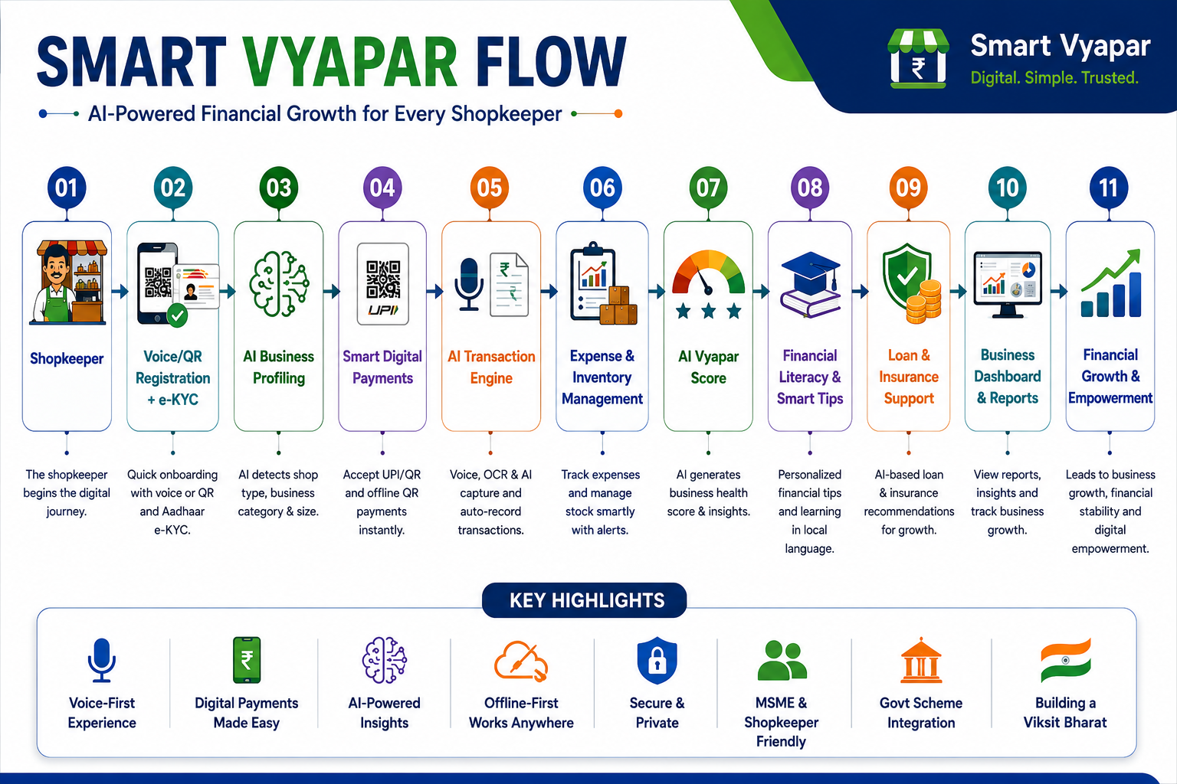
Process flow diagram or Use-case diagram:

Slide 6
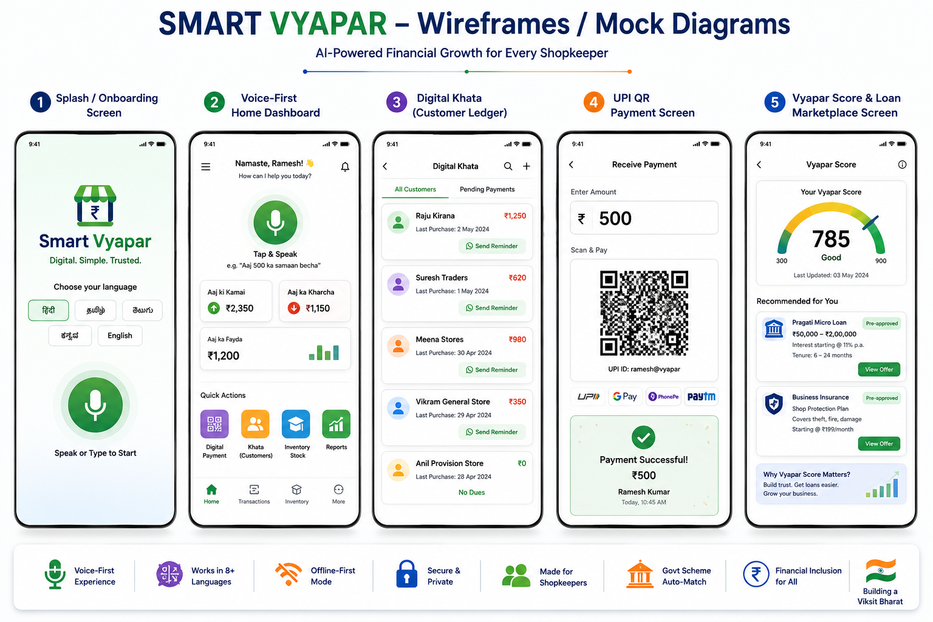

Slide 7
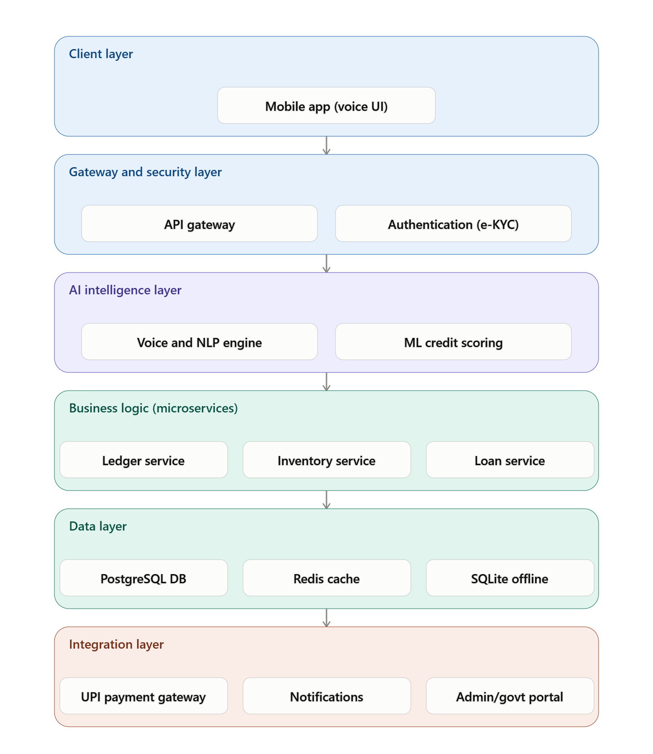
Architecture diagram of the proposed solution
Block Explanations
Mobile App: Cross-platform, low-end device optimized, voice-first UI.
API Gateway: Secures and routes all requests, handles rate limiting.
Authentication: Aadhaar e-KYC + OTP for compliant, secure identity verification.
AI Engine: Uses Bhashini API (speech-to-text for Indian languages) + NLP model to convert voice into structured data; ML model computes Vyapar Score.
Business Logic Layer: Microservices handle ledger, inventory, and loan workflows independently for scalability.
Payment Gateway: Integrates NPCI UPI API and payment aggregators for instant settlement.
Database: PostgreSQL for transactional data, Redis for speed, SQLite for offline-first devices.
Analytics Engine: Detects spending patterns, flags anomalies/fraud.
Notification System: Reaches users via WhatsApp Business API and SMS for low-smartphone-usage areas.
Admin/Govt Portal: Connects shopkeeper data (with consent) to government scheme databases and lending partners via the Account Aggregator framework.

Slide 8
Technologies to be used in the solution:
Layer | Technology | Why Chosen
Frontend | React Native / Flutter | Cross-platform, fast & lightweight
Backend | Node.js (Express) | Scalable REST APIs & microservices
Database | PostgreSQL + Redis + SQLite | Reliable, fast & offline support
Authentication | Aadhaar e-KYC + Firebase Auth + OTP | Secure user verification
Cloud | AWS / Azure | Scalable cloud infrastructure
AI | Bhashini API + Whisper | Multilingual voice recognition
Machine Learning | TensorFlow / Scikit-learn | AI Vyapar Score & predictions
Payment API | NPCI UPI + Razorpay | Secure digital payments
Maps | Google Maps API | Shop location & nearby services
Notifications | Firebase Cloud Messaging | Instant alerts & reminders
Analytics | Firebase Analytics / Mixpanel | User & business insights
Deployment | Docker + Kubernetes | Easy deployment & scalability
Security | OAuth 2.0 + End-to-End Encryption | Data privacy & protection
Version Control | Git + GitHub | Team collaboration
Testing | Jest + Postman | API & application testing

Slide 9





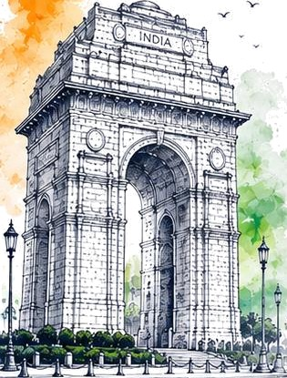





FRONTEND
PROJECT
ARENA
P R E 0 E N TS
:.%...
VIKSIT
BHARAT Bi
Innovate for lndio. Build for Tomorrow.
THANK YOU.^{i}
FOR BEING
A PART OF

